Slide 1
Unit I - INTRODUCTION TO FORECASTING

Slide 2
Evaluating and Monitoring Forecasting Model Performance, R Commands.
It is important to carefully define the meaning of performance.
It is tempting to evaluate performance on the basis of the fit of the forecasting or time series model to historical data.
When choosing models, it is common practice to separate the available data into two portions, training and test data,
where the training data is used to estimate any parameters of a forecasting method and
the test data is used to evaluate its accuracy.
The size of the test set is typically about 20% of the total sample

Slide 3
The test set should ideally be at least as large as the maximum forecast horizon required.
The following points should be noted.
A model which fits the training data well will not necessarily forecast well.
A perfect fit can always be obtained by using a model with enough parameters.
Over-fitting a model to data is just as bad as failing to identify a systematic pattern in the data.

Slide 4
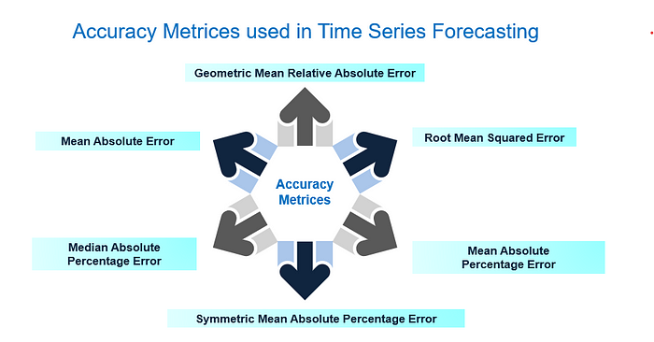

Slide 5
Mean Absolute Error (MAE)
In R Programming Language Mean Absolute Error (MAE) measures the average absolute difference between the predicted and actual values. It provides a straightforward assessment of forecast accuracy.
The Mean Absolute Error (MAE) is a commonly used metric for measuring the accuracy of predictions or forecasts.
set.seed(123)
actual_data <- rnorm(100)
forecast_data <- actual_data + rnorm(100, sd = 0.5)
# Calculate Mean Absolute Error (MAE)
mae <- mean(abs(actual_data - forecast_data))
cat("Mean Absolute Error (MAE):", mae, "\n")

Slide 6
MAE = (1 / n) * Σ |actual — forecast|
Where:
MAE is the Mean Absolute Error.
n is the number of data points (samples). Σ represents the sum over all data points. |actual — forecast| is the absolute difference between the actual value and the forecasted value for each data point.
# Calculate Mean Absolute Error (MAE) mae = mean_absolute_error(final_test_data['y'], final_test_data['AutoARIMA']) # Print MAE print(f"Mean Absolute Error (MAE): {mae:.4f}")

Slide 7
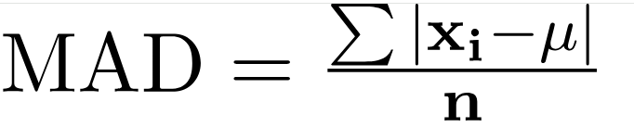
Mean Absolute Deviation (MAD)
Mean Absolute Deviation (MAD) of a data set is the average distance between each data point of the data set and the mean of data.
For Ungrouped Data
The Mean Absolute Deviation Formula for ungrouped data is given as follows:
where,
x_{i} represents the each observation of the dataset,
μ is the mean of the data set, and
n is the number of observations in the data set.
Both the mean absolute deviation (MAD) and the mean squared error (MSE) measure the variability in forecast errors.

Slide 8
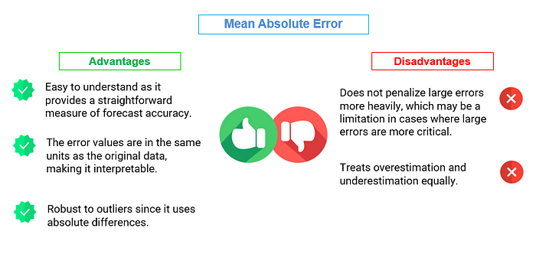

Slide 9
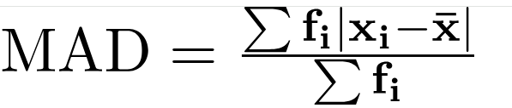
For Grouped Data
The Mean Absolute Deviation Formula for grouped data is given as follows:
Where,
xi represents the each observation of the dataset,
{x} is mean of dataset
fi represents frequency of corresponding observation xi,
1 < i < n and n is the number of data points in the data set.

Slide 10
How to Calculate Mean Absolute Deviation?
To calculate the mean absolute deviation for a set of values, we can use the following steps:
Step 1: Identify whether the data set is either grouped or ungrouped and calculate the Mean.
Step 2: Calculate the absolute difference between each data point and the mean.
Step 3: Add the Absolute Difference calculated for each data point in the step 2.
Step 4: Dividing the sum of absolute difference by the number of data points given to calculate the mean abosolute deviation.

Slide 11
Parameters | Mean Absolute Deviation | Standard Deviation
Definition | The average distance between each data point and the mean. | The measure of how spread out the data is from the mean.
Calculation | 1. Calculate the mean of the data set. 2. Calculate the absolute value of the difference between each data point and the mean. 3. Take the average of those absolute values. | 1. Calculate the mean of the data set. 2. Calculate the difference between each data point and the mean. 3. Square each of those differences. 4. Take the average of the squared differences. 5. Take the square root of the result.
Use | Useful when the data set contains outliers, as it is not affected by extreme values. | Useful when the data set does not contain outliers, as it provides a more accurate measure of the spread of the data.

Slide 12
Root Mean Squared Error (RMSE)
The Root Mean Squared Error (RMSE) is another widely used metric for measuring the accuracy of predictions or forecasts.
RMSE quantifies the average magnitude of errors between the predicted or forecasted values and the actual values, giving more weight to larger errors.
It’s an important metric, especially when larger errors are of greater concern.
Notes:
https://www.geeksforgeeks.org/evaluating-forecast-accuracy/

Slide 13
RMSE = √((1 / n) * Σ(actual — forecast)²)
Where:
RMSE is the Root Mean Squared Error.
n is the number of data points (samples).
Σ represents the sum over all data points.
(actual — forecast)² is the squared difference between the actual value and the forecasted value for each data point.
# Calculate the Root Mean Squared Error (RMSE) rmse = mean_squared_error(final_test_data['y'], final_test_data['AutoARIMA'], squared=False) # Print the RMSE print(f"Root Mean Squared Error (RMSE): {rmse:.4f}")

Slide 14
# R program to illustrate RMSE
# Importing the required package
library(Metrics)
# Taking two vectors
actual = c(1.5, 1.0, 2.0, 7.4, 5.8, 6.6)
predicted = c(1.0, 1.1, 2.5, 7.3, 6.0, 6.2)
# Calculating RMSE using rmse()
result = rmse(actual, predicted)
# Printing the value
print(result)

Slide 15
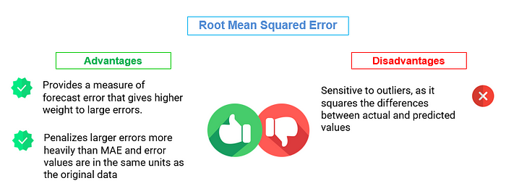

Slide 16
Mean Absolute Percentage Error (MAPE)
Definition 1:The Mean Absolute Percentage Error (MAPE) is a metric used to measure the accuracy of predictions or forecasts as a percentage of the actual values.
Definition 2: Mean Absolute Percentage Error (MAPE) expresses the forecast accuracy as a percentage of the absolute percentage difference between the predicted and actual values.
It quantifies the average percentage difference between the predicted or forecasted values and the actual values.
# Calculate Mean Absolute Percentage Error (MAPE)
mape <- mean(abs((actual_data - forecast_data) / actual_data)) * 100
cat("Mean Absolute Percentage Error (MAPE):", mape, "%\n")
Notes:
https://www.geeksforgeeks.org/evaluating-forecast-accuracy/

Slide 17
MAPE = (1 / n) * Σ(|(actual — forecast) / actual|) * 100%
Where:
n is the number of data points (samples).
Σ represents the sum over all data points.
|(actual — forecast) / actual| is the absolute percentage difference between the actual value and the forecasted value for each data point.
mape = np.mean(np.abs((final_test_data['y'] - final_test_data['AutoARIMA'])/ final_test_data['y'])) * 100 print(f"Mean Absolute Percentage Error (MAPE): {mape:.4f}")

Slide 18
# Import library R code
library("MLmetrics")
# Create a dataframe
dataframe <- data.frame(At=c(15, 40, 41, 32, 48, 28, 21, 47, 36, 37, 11, 14),
Ft=c(32, 41, 43, 54, 66,51, 46, 45, 37, 33, 25, 26))
# Compute MAPE
MAPE(dataframe$Ft, dataframe$At)
Notes:
https://machinelearningmastery.com/time-series-forecasting-performance-measures-with-python/
https://cran.r-project.org/web/packages/forecast/forecast.pdf

Slide 19
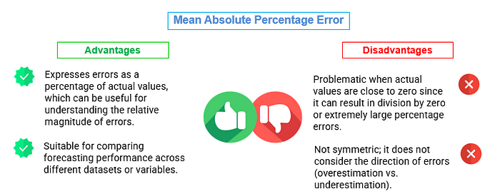

Slide 20
Symmetric Mean Absolute Percentage Error (SMAPE)
The Symmetric Mean Absolute Percentage Error (SMAPE) is a metric used for measuring the accuracy of predictions or forecasts in time series analysis.
It’s particularly useful when you want to assess forecast accuracy while considering both overestimation and underestimation errors.
The result is multiplied by 100% to express the error as a percentage.

Slide 21
SMAPE = (1 / n) * Σ(2 * |actual — forecast| / (|actual| + |forecast|)) * 100%
Where:
SMAPE is the Symmetric Mean Absolute Percentage Error, expressed as a percentage.
n is the number of data points (samples).
Σ represents the sum over all data points.
|actual — forecast| is the absolute difference between the actual value and the forecasted value for each data point. |actual| and |forecast| are the absolute values of the actual and forecasted values, respectively.
smape = np.mean((np.abs(final_test_data['y'] - final_test_data['AutoARIMA']) /((np.abs(final_test_data['y'] +np.abs(final_test_data['AutoARIMA'])) / 2))) * 100 print(f"Symmetric Mean Absolute Percentage Error (SMAPE): {smape:.4f}")

Slide 22
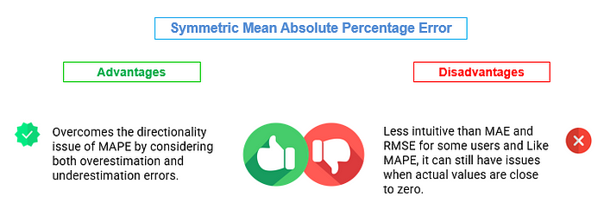
Notes:
https://medium.com/analytics-vidhya/assessment-of-accuracy-metrics-for-time-series-forecasting-bc115b655705

Slide 23
Median Absolute Percentage Error (MDAPE)
MDAPE stands for Median Absolute Percentage Error.
It is a performance metric used to evaluate the accuracy of forecasts in time series analysis.
MDAPE = Median(|(Actual — Forecast) / Actual|) * 100%
Where:
Actual represents the actual values or observations in the time series.
Forecast represents the corresponding forecasted values.
MDAPE is expressed as a percentage, and it measures the median percentage difference between the actual and forecasted values. It is particularly useful when dealing with time series data that may have extreme values or outliers because it focuses on the middle value of the distribution of percentage errors.

Slide 24
mdape = np.median(np.abs((final_test_data['y'] - final_test_data['AutoARIMA'])/ final_test_data['y']))*100 print(f"Median Absolute Percentage Error (MDAPE): {mdape:.4f}")

Slide 25
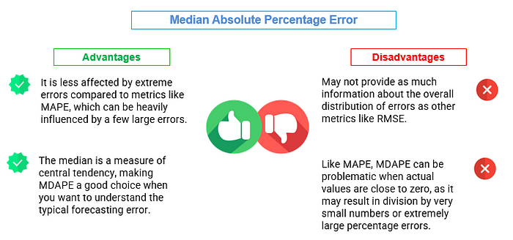

Slide 26
Geometric Mean Relative Absolute Error (GMRAE)
The Geometric Mean Relative Absolute Error (GMRAE) is a metric used to assess the accuracy of predictions or forecasts in time series analysis.
It takes the geometric mean of the relative absolute errors, providing a single aggregated measure of forecast accuracy.

Slide 27
GMRAE = (Π |(actual — forecast) / actual|)^(1/n) * 100%
Where:
GMRAE is the Geometric Mean Relative Absolute Error, expressed as a percentage.
Π represents the product over all data points.
|actual — forecast| is the absolute difference between the actual value and the forecasted value for each data point. |(actual — forecast) / actual| is the relative absolute error for each data point.
n is the number of data points (samples).
gmrae =np.prod(np.abs((final_test_data['y'] - final_test_data['AutoARIMA'])/ final_test_data['y']) ** (1/len(final_test_data["y"])))*100 print(f"Geometric Mean Relative Absolute Error (GMRAE): {gmrae:.4f}")

Slide 28
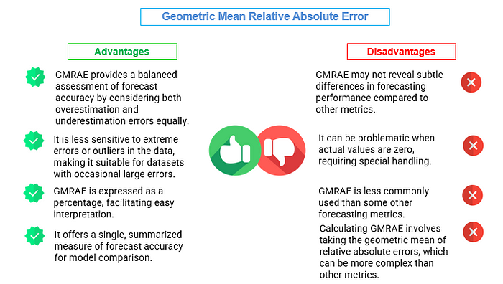
Notes:
https://medium.com/analytics-vidhya/assessment-of-accuracy-metrics-for-time-series-forecasting-bc115b655705

Slide 29
R Commands
https://cran.r-project.org/web/views/TimeSeries.html
https://www.statmethods.net/advstats/timeseries.html

Slide 30
The forecast package in R
The following list shows all the functions that produce forecast objects.
meanf()
naive(), snaive()
rwf()
croston()
stlf()
ses()
holt(), hw()
splinef()
thetaf()
forecast()
Notes:
https://otexts.com/fpp2/the-forecast-package-in-r.html

Slide 31
Ts class
The easiest way to create a time series object in R is to use the ts() function.
This function uses the following basic syntax:
ts(data, start, end, frequency)
where:
data: A vector or matrix of time series values
start: The time of the first observation
end: The time of the last observation
frequency: The number of observations per unit of time.

Slide 32
Example 1: Create Time Series with Monthly Data
Suppose we have the following vector called data that contains the number of sales made by some retail store during 20 consecutive months, starting on October 1st, 2023:
#create vector of 20 values
data <- c(6, 7, 7, 7, 8, 5, 8, 9, 4, 9, 12, 14, 14, 15, 18, 24, 20, 15, 24, 26)

Slide 33
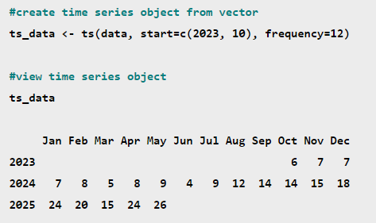
We can use the ts() function and specify frequency=12 to create a time series object from this vector:

Slide 34
#create vector of 20 values
data <- c(6, 7, 7, 7, 8, 5, 8, 9, 4, 9, 12, 14, 14, 15, 18, 24, 20, 15, 24, 26)
#create time series object from vector
ts_data <- ts(data, start=2023, frequency=1)
#view time series object
Time Series:
Start = 2000
End = 2019
Frequency = 1
[1] 6 7 7 7 8 5 8 9 4 9 12 14 14 15 18 24 20 15 24 26
#display class of ts_data object
class(ts_data)
[1] "ts“
#create line plot of time series data
plot(ts_data)
Example 2: Create Time Series with Yearly Data
Suppose we have the following vector called data that contains the number of sales made by some retail store during 20 consecutive years, starting in 2000:
Notes:
https://www.tutorialspoint.com/r/r_time_series_analysis.htm

